Slide 1
Volatility-Based Allocation with Factor Selection on STI Constituents
QF5210 Financial Time Series · Group Project
Group White Noise
Chung Yunchi · Yang Huiqing · Zhao Yaqi · Zhang Renenwei · Yao Yuhan
Date: 7 November 2026

Slide 2

Contents
01
02
03
Factor selection and portfolio construction
Motivation and literature
Data: point-in-time universe
04
05
Results and robustness
Conclusions and Implications

Slide 3
CHAPTER 01
Motivation and Literature
Two open questions: volatility allocation and factor selection on the STI

Slide 4

Two questions the literature leaves open for the STI
Q1 · Risk Management
Momentum and reversal
Lehmann(1990);
Jegadeesh & Titman (1993)
Medium-term momentum and short-term return reversals motivate stock-ranking signals.
Low volatility
Ang, Hodrick, Xing & Zhang (2006);
Frazzini & Pedersen (2014)
Low-risk characteristics can be associated with higher risk-adjusted returns.
Can volatility targeting reduce portfolio risk without substantially sacrificing returns?
Volatility-managed portfolios
Moreira & Muir (2017)
Cutting exposure when volatility is high raises Sharpe ratios.
Machine-learning factor selection
Gu, Kelly & Xiu (2020)
Penalised models combine many signals into one score.
Q2 · Factor Selection
Can factor-based stock selection outperform the STI after transaction costs?
Gap we address: Evidence from broad equity markets may not directly generalize to the concentrated STI universe.
STI: a concentrated market of approximately 30 large-cap stocks.

Slide 5
CHAPTER 02
Data: point-in-time universe
Only stocks actually in the STI on each signal date, 2014 to Oct 2026

Slide 6
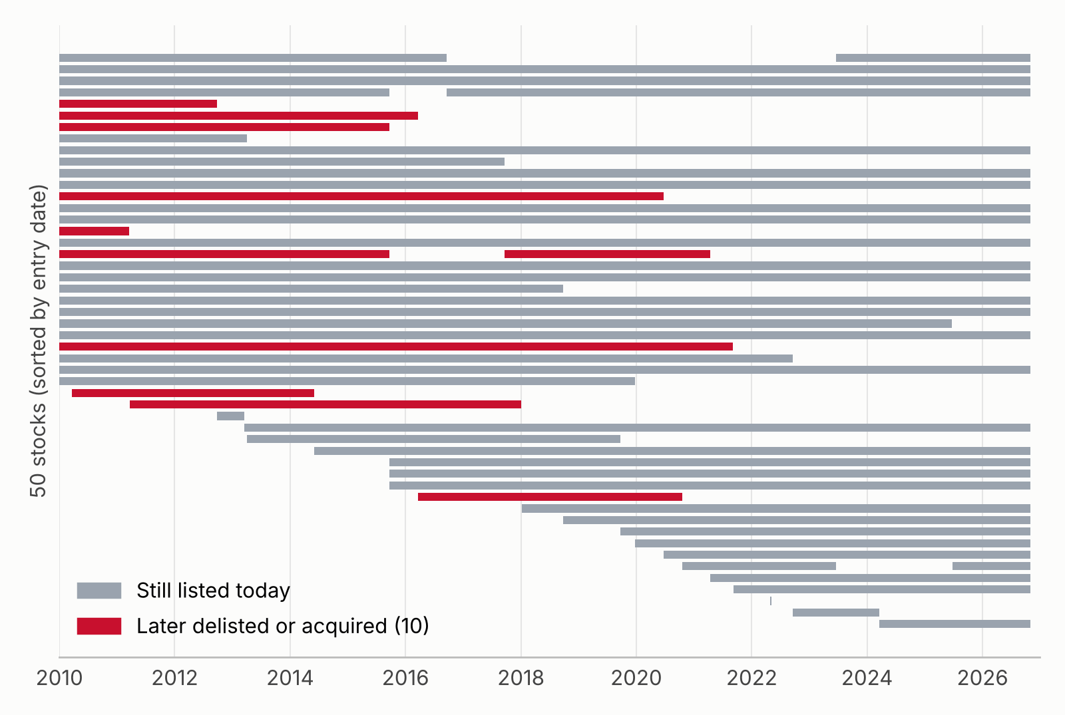
Point-in-Time STI Constituents
50
Candidate stocks: every STI member in the sample
10
Later delisted or acquired, kept in the sample
~30
Tradable constituents each week
Buy only after a stock joins
Sell at the next rebalance after it leaves
Delisted: cash at its last trade
Train 2014–2022 · Validation 2023 – Jul 2026 · Test Oct 2026

Slide 7
CHAPTER 03
Factor selection and portfolio construction
19 factors tested, 8 pass IC; rolling Lasso, 1/sigma weights, vol target

Slide 8
Factor Screening: 8 of 19 Selected
Momentum & Reversal
mom12_1 · rev5
Trends persist over months;
Short-term overreaction reverses.
Value & Income
ep_ttm · fep · dy
Earnings and dividend yields as valuation signals.
Analyst Revisions
rev
Changes in forward earnings expectations.
Risk & Trading Behaviour
vol20 · overnight20
Low-volatility stocks earn more;
Overnight run-ups tend to fade.

Slide 9
Portfolio Construction & Control Groups
1 Select
Rolling Lasso score → top 15 stocks λ chosen by after-cost Sharpe
2 Weight
w ∝ 1/σ (EWMA 0.94)
Caps 15% per stock, sector +10 pp
3 Scale
GARCH(1,1)-t forecast
Exposure=min(1, 15%/σp), rest in cash
Group | Stocks | Weights | Exposure
B0 | STI index | — | 100%
B0′ | All constituents | Market cap | 100%
B1 | All constituents | Equal | 100%
A1 | All constituents | 1/σ | 100%
A2 | All constituents | 1/σ | Vol target
S1 | Top 15 by score | Equal | 100%
S2 | Top 15 by score | 1/σ | 100%
S3 | Top 15 by score | 1/σ | Vol target
How parameters were chosen
Validation rule
Accept changes only if validation Sharpe improves ≥ 0.05 and training also improves.
Frozen parameters
K = 15 stocks; 15% volatility target. Frozen on 30 Sep 2026.
Trading protocol
Monday-close signals → Tuesday-open trades; 15 bps one-way cost.

Slide 10
CHAPTER 04
Results and robustness
After costs no portfolio beats the STI; vol target cuts drawdowns

Slide 11
Out-of-Sample Strategy Attribution
FACTOR SELECTION
INVERSE-VOL WEIGHTS
GARCH TARGET
S1 − B1
S2 − S1
S3 − S2
−0.60 pp
+0.04 pp
0.00 pp
Selection lagged equal weighting
A small positive difference
Exposure stayed at 100%
Interpretation：
S3 beat the STI modestly, but in this 20-day window Lasso selection lagged equal weighting; over the full sample the difference is small (Sharpe 0.50 vs 0.47) and GARCH did not de-risk. The result is not evidence of component-specific alpha.

Slide 12
October 2026 Test Performance
S3 AFTER COSTS
STI BENCHMARK
RELATIVE RETURN
−4.64%
−4.92%
+0.28 pp
Cumulative test returns · 1–29 October 2026 (20 trading days)
STI
-4.92%
B0′
-4.78%
B1
-4.08%
A1/A2
-4.29%
S1
-4.68%
S2/S3
-4.64%
All portfolios declined, but each lost less than the STI; S3 outperformed by 0.28 percentage points.
Built at the 1 Oct open, rebalanced 6, 13, 20 and 27 Oct, run once with frozen parameters. Exposure stayed 100%, so S3 = S2 and A2 = A1.

Slide 13
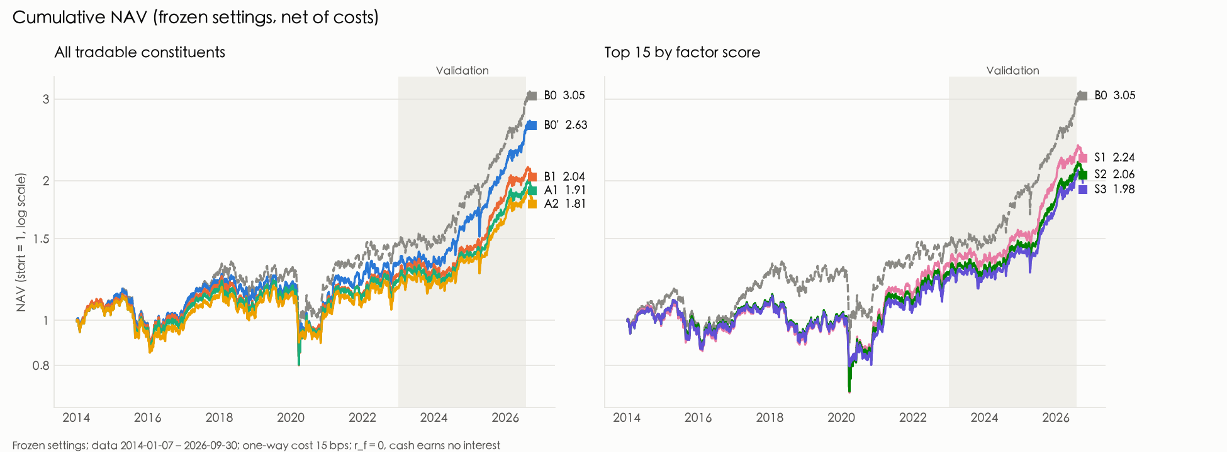
Historical Backtest Performance
No portfolio beats the STI after costs
0.72
STI Sharpe ratio
2014 – Sep 2026
0.49
S3 full strategy Sharpe, after costs
−4.6%
vs
−4.9%
S3 vs STI in the Oct 2026 test (20 days)

Slide 14



Volatility Targeting vs. Trading Costs
Risk control: GARCH targeting reduces maximum drawdown by approximately 9 percentage points.
Trading costs: S3 Sharpe falls from 0.77 to 0.49 after costs, with approximately 2.9% annual trading costs.
Predictability: Validation Rank IC is only 0.007 (t = 0.48), suggesting weak out-of-sample signals.

Slide 15
Robustness & Sensitivity Analysis
Transaction Costs Dominate
Sharpe falls from 0.58 to 0.22 as costs rise from 10 to 30 bps, highlighting the strategy's sensitivity to trading frictions.
Rebalancing Frequency Matters
Monthly rebalancing improves after-cost Sharpe from 0.49 to 0.59, but increases maximum drawdown from 29.6% to 35.1%.
Portfolio Size Sensitivity
Reducing K from 15 to 12 lowers Sharpe from 0.49 to 0.29, suggesting parameter sensitivity and potential validation overfitting.

Slide 16
CHAPTER 05
Conclusions and Implications
What worked, what did not, and what we would do next

Slide 17
Conclusions & Implications
Q1 Volatility Allocation
Q2 Factor Selection
Effective Downside Protection
No Persistent After-Cost Alpha
GARCH targeting reduces maximum drawdown by 9–10 pp, while inverse-volatility weighting alone offers limited benefits.
S3 Sharpe falls from 0.77 before costs to 0.49 after costs, below the STI benchmark of 0.72.
Contributions
Limitations
Future Research
• Point-in-time STI universe, including delisted stocks.
• Short validation and test periods; sensitivity to K and costs.
• Reduce turnover while preserving downside protection.
• Cost-aware Lasso selection and controlled volatility experiments.
• Training-period factor-screen bias.
• Evaluate performance over a longer independent test period.
KEY TAKEAWAY
Volatility targeting improves downside protection, but consistent after-cost alpha remains unproven.

Slide 18
Team Contributions
CY
Chung Yunchi
Data collection, factor model, backtest framework, volatility experiments
YH
Yang Huiqing
Backtest framework, literature review, rebalancing frequency
ZY
Zhao Yaqi
Factor design, factor testing and correlation, 1-minute video
ZR
Zhang Renenwei
Factor design, factor testing and correlation, 1-minute video
YY
Yao Yuhan
Presentation, synthesis and explanation of results

Slide 19
References
Factor foundations
Risk, volatility & modelling
Fama, E. F., & French, K. R. (1992). The cross-section of expected stock returns. Journal of Finance, 47(2), 427–465.
Ang, A., Hodrick, R. J., Xing, Y., & Zhang, X. (2006). The cross-section of volatility and expected returns. Journal of Finance, 61(1), 259–299.
Jegadeesh, N., & Titman, S. (1993). Returns to buying winners and selling losers. Journal of Finance, 48(1), 65–91.
Frazzini, A., & Pedersen, L. H. (2014). Betting against beta. Journal of Financial Economics, 111(1), 1–25.
Lehmann, B. N. (1990). Fads, martingales, and market efficiency. Quarterly Journal of Economics, 105(1), 1–28.
Moreira, A., & Muir, T. (2017). Volatility-managed portfolios. Journal of Finance, 72(4), 1611–1644.
Asness, C. S., Moskowitz, T. J., & Pedersen, L. H. (2013). Value and momentum everywhere. Journal of Finance, 68(3), 929–985.
Bollerslev, T. (1986). Generalized autoregressive conditional heteroskedasticity. Journal of Econometrics, 31(3), 307–327.
Asness, C. S., Frazzini, A., Israel, R., & Moskowitz, T. J. (2014). Fact, fiction, and momentum investing. Journal of Portfolio Management.
Tibshirani, R. (1996). Regression shrinkage and selection via the lasso. JRSS Series B, 58(1), 267–288.
Amihud, Y. (2002). Illiquidity and stock returns. Journal of Financial Markets, 5(1), 31–56.
Gu, S., Kelly, B., & Xiu, D. (2020). Empirical asset pricing via machine learning. Review of Financial Studies, 33(5), 2223–2273.
Drobetz, W., & Otto, T. (2021). Empirical asset pricing via machine learning: Evidence from the European stock market. Journal of Asset Management, 22, 507–538.

Slide 20
Thanks
Questions ＆ Discussion
Group White Noise
Chung Yunchi · Yang Huiqing · Zhao Yaqi · Zhang Renenwei · Yao Yuhan

Slide 21
Appendix
Full results tables, parameter choices and research history

Slide 22
A1 Performance with frozen parameters (after costs)
Portfolio | Train Sharpe | Valid Sharpe | Full Sharpe | Full ann. return | Max drawdown | Weekly turnover
B0 STI | 0.32 | 1.98 | 0.72 | 9.2% | −33.5% | —
B0′ cap-weighted | 0.24 | 1.88 | 0.63 | 7.9% | −33.5% | 0.6%
B1 equal | 0.20 | 1.45 | 0.47 | 5.8% | −35.8% | 0.5%
A1 1/σ | 0.17 | 1.38 | 0.43 | 5.2% | −34.5% | 1.2%
A2 1/σ + vol target | 0.17 | 1.40 | 0.45 | 4.8% | −24.9% | 1.7%
S1 selected, equal | 0.23 | 1.52 | 0.50 | 6.6% | −38.3% | 17.0%
S2 selected, 1/σ | 0.20 | 1.48 | 0.46 | 5.9% | −38.4% | 17.9%
S3 selected, 1/σ + target | 0.20 | 1.49 | 0.49 | 5.5% | −29.6% | 17.9%
Training 2014-01 – 2022-12 · Validation 2023-01 – 2026-07 · Full 2014-01 – 2026-09 · r_f = 0, cash earns nothing · before costs S3 full Sharpe = 0.77

Slide 23
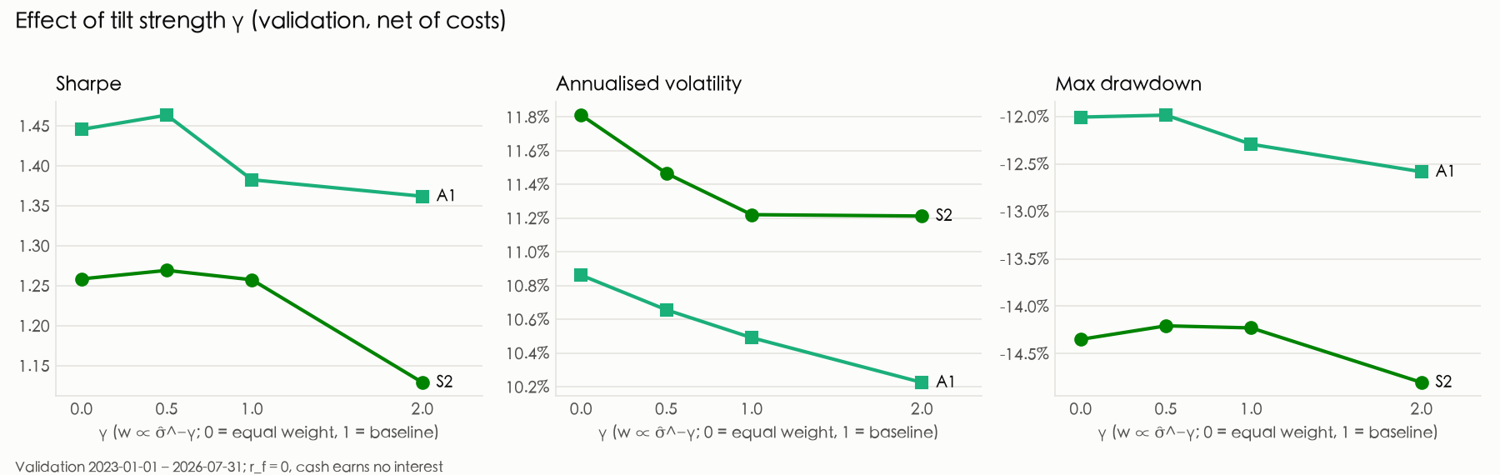
A2 Volatility experiments and parameter choice
Experiment | Options (baseline first) | Best on validation | Chosen
E1 σ method (S2) | EWMA 0.94, 20/60-day SD, EWMA 0.97, Parkinson, GARCH | 60-day SD (+0.05, train worse) | EWMA 0.94
E2 tilt γ (S2) | γ = 1, 0, 0.5, 2 | γ = 0.5 (+0.01) | γ = 1
V1 vol target (S3) | 12%, 10%, 15% | 15% (+0.05, train better) | 15%
K stocks (S3) | 12, 8, 10, 15 | 15 (+0.30, train better) | 15
Sector cap (S3) | +10 pp, +15 pp | +10 pp | +10 pp
Rule: keep a change only if validation Sharpe rises ≥ 0.05 and training Sharpe also rises; otherwise keep the baseline.

Slide 24
A3 The 8 selected factors
Factor | Definition | Sign | NW t | Lasso use
mom12_1 | Return from t−252 to t−21 days | + | 3.18 | 84%
rev5 | Minus the 5-day return | + | 2.95 | 97%
dy | Past-year dividends / price | + | 2.89 | 65%
overnight20 | 20-day sum of overnight log returns | − | 2.89 | 71%
rev | 3-month change in forward EPS / price | + | 2.61 | 43%
ep_ttm | Trailing earnings / price, lagged 5 days | + | 2.49 | 74%
fep | Forward 12-month EPS / price | + | 2.45 | 71%
vol20 | 20-day return standard deviation | − | 2.19 | 73%
NW t: Newey–West t of weekly Rank IC, 2011–2022. Lasso use: share of weeks with a non-zero coefficient, 2014 – Sep 2026. All factors are sector- and size-neutralised.

Slide 25
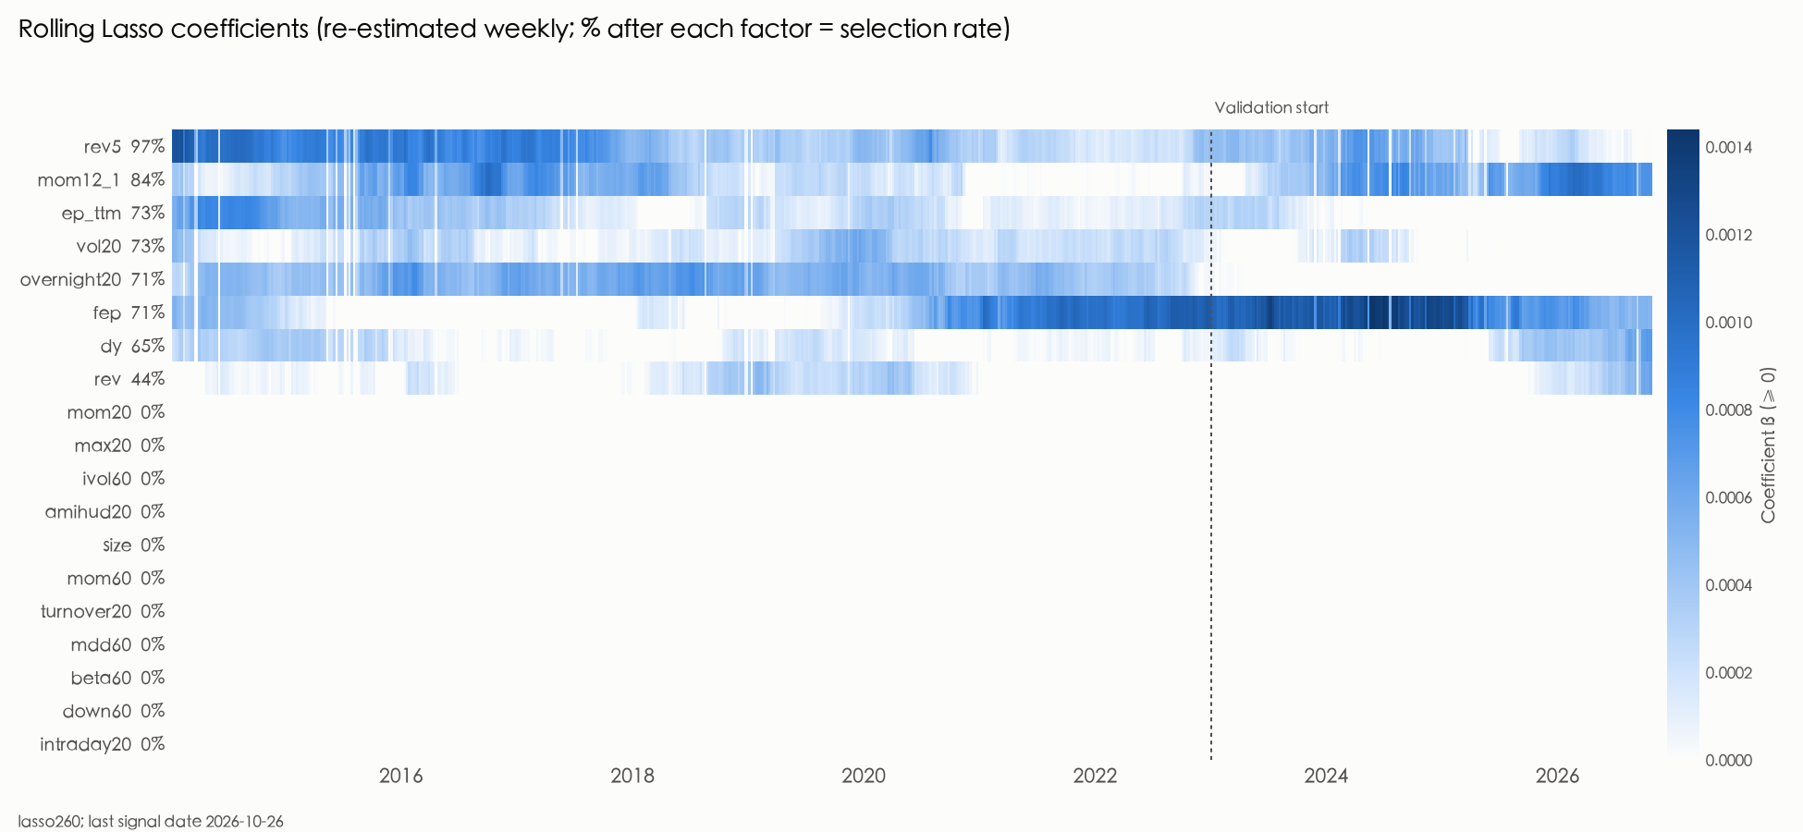
A4 Lasso coefficients over time

Slide 26
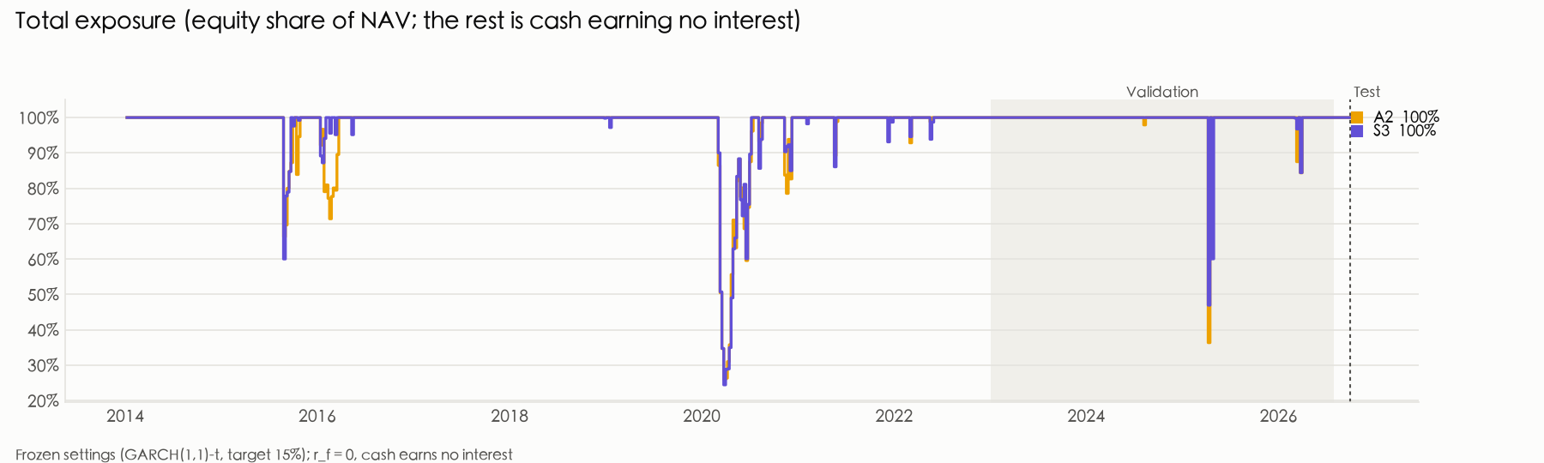
A5 How the volatility target behaves
S3, 2020 stress | No target | 15% (chosen) | 12% | 10%
Average exposure | 100% | 62% | 55% | 48%
Max drawdown | −31.3% | −22.3% | −19.4% | −17.3%

